Slide 1


Quantitative Dual-Color Direct Stochastic Optical Reconstruction Microscopy
Peter Hoboth
Laboratory of Biology of the Cell Nucleus
Laboratory of Confocal
and Fluorescence Microscopy

Slide 2
Overview
Introduction – theoretical background
Super-resolution microscopy; single-molecule localization microscopy
Direct stochastic optical reconstruction microscopy (dSTORM)
Quantitative dual-color dSTORM (Q-DC-dSTORM)
The role of nuclear lipids in the regulation of gene expression
Biology of nuclear phosphatidylinositol phosphates (nPIPs)
Application of Q-DC-dSTORM to study spatial distribution of nPIPs
Hands on: Q-DC-dSTORM

Slide 3
Introduction – theoretical background
Super-resolution microscopy; single-molecule localization microscopy
Direct stochastic optical reconstruction microscopy (dSTORM)
Quantitative dual-color dSTORM (Q-DC-dSTORM)

Slide 4
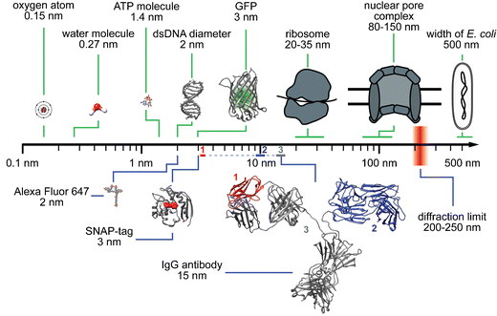
Spatial Scales in Biology and Microscopy
Adapted from Turkowyd et al., 2016

Slide 5
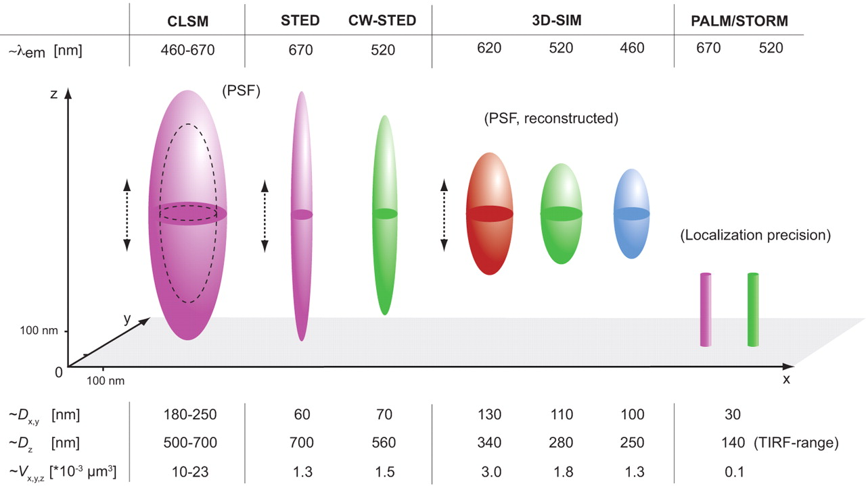
Spatial Resolutions in Imaging Techniques
Adapted from Schermelleh et al., 2010

Slide 6
Super-resolution Microscopy Techniques: Structured Illumination Microscopy and Single Molecule Localization Microscopy
Adapted from Schermelleh et al., 2010

Slide 7
A
H2B-SNAP-JF549
RNAPII
B
Wide-field
3D-SIM
(MIP)
Adapted from Hoboth et al., Int J Mol Sci 2021

Slide 8
Super-resolution Microscopy Techniques: Structured Illumination Microscopy and Single Molecule Localization Microscopy
Adapted from Schermelleh et al., 2010

Slide 9
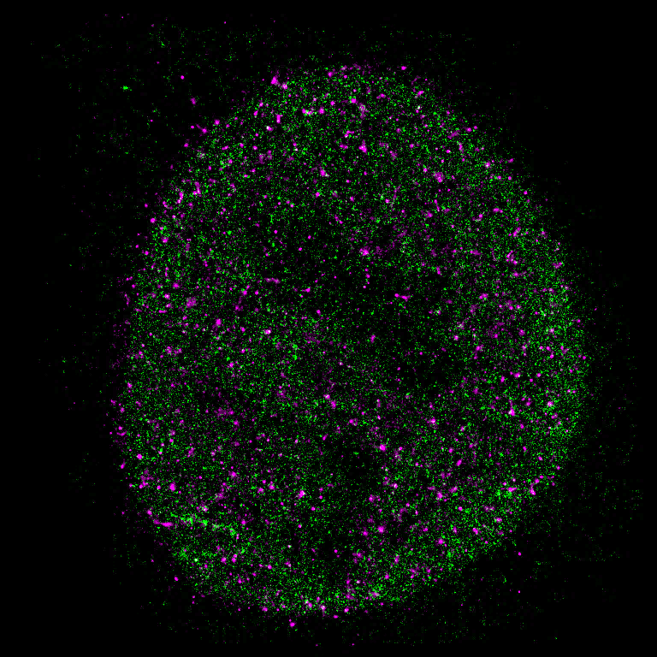
E
F
Wide-field
dSTORM
Adapted from Hoboth et al., Int J Mol Sci 2021

Slide 10
Single Molecule Localization Microscopy
Adapted from Schermelleh et al., 2010
Adapted from Schermelleh et al., 2010

Slide 11
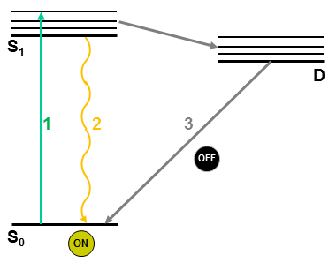
SMLM is Based on the Fluorophore Transition between Fluorescent (On) and Dark (Off) State (Blinking)
Adapted from Abberior

Slide 12
Fluorophores Useful for SMLM
Adapted from Liu et al., 2015

Slide 13
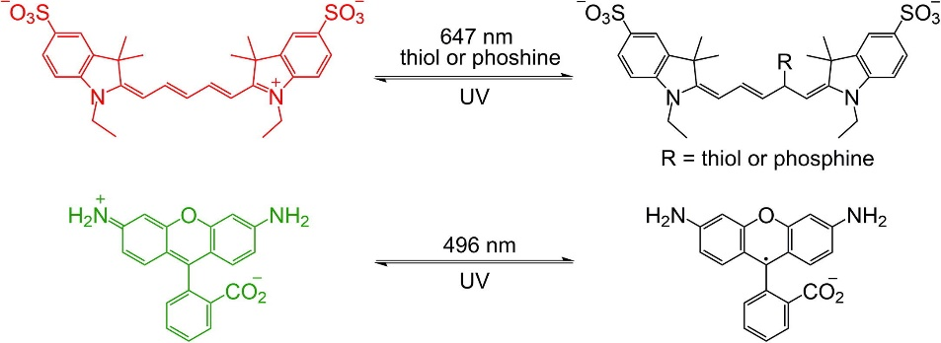
Example Mechanisms of Photoswitching
Adapted from Chozinski et al., 2014
Notes:
Example mechanisms for photoswitching of a cyanine and rhodamine fluorophore. (Top) Upon incubation with a phosphine or illumination with 647 nm light in the presence of a thiol or phosphine, Cy5 transitions to a non-fluorescent state adduct consisting of the phosphine or thiol bound to the polymethine bridge. Illumination with ultraviolet light can dissociate the adduct. (Bottom) Several rhodamine fluorophores can be converted to a long-lived, non-fluorescent radical upon illumination with light at their main absorption band in the absence of oxygen. The dark form may be photoactivated by illumination with ultraviolet light

Slide 14
Example Mechanisms of Photoswitching
Adapted from Chozinski et al., 2014
Notes:
Example mechanisms for photoswitching of a cyanine and rhodamine fluorophore. (Top) Upon incubation with a phosphine or illumination with 647 nm light in the presence of a thiol or phosphine, Cy5 transitions to a non-fluorescent state adduct consisting of the phosphine or thiol bound to the polymethine bridge. Illumination with ultraviolet light can dissociate the adduct. (Bottom) Several rhodamine fluorophores can be converted to a long-lived, non-fluorescent radical upon illumination with light at their main absorption band in the absence of oxygen. The dark form may be photoactivated by illumination with ultraviolet light

Slide 15
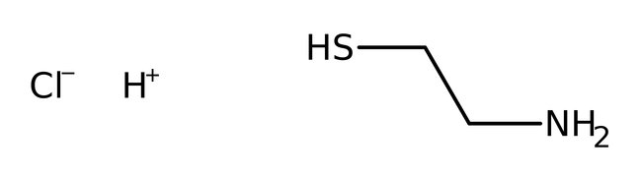
Photochemistry of Alexa Fluor 647
Adapted from Fan et al., 2019
Notes:
In quantum mechanics, a triplet is a quantum state of a system with a spin of quantum number s =1, such that there are three allowed values of the spin component, m_{s} = −1, 0, and +1.
Spin, in the context of quantum mechanics, is not a mechanical rotation but a more abstract concept that characterizes a particle's intrinsic angular momentum. It is particularly important for systems at atomic length scales, such as individual atoms, protons, or electrons.
Almost all molecules encountered in daily life exist in a singlet state, but molecular oxygen is an exception.^{[1]} At room temperature, O₂ exists in a triplet state, which can only undergo a chemical reaction by making the forbidden transition into a singlet state. This makes it kinetically nonreactive despite being thermodynamically a strong oxidant. Photochemical or thermal activation can bring it into the singlet state, which makes it kinetically as well as thermodynamically a strong oxidant.

Slide 16
Principle of the single-fluorophore localization
Adapted from Manley et al., 2010
Notes:
PALM and STORM with using a stochastic readout of individual molecules prepared in the on-state, while the majority of molecules are kept in the off-state. The major advantage over PALM and STORM is that both states can be realized as electronic states, i.e. much faster switching times, thus faster recording, can be realized.
After nanoscale precise read-out of the localization of individual molecules they are switched back to the dark-state.
After excitation (1) from the ground state S0 into the first excited state S1, the molecule has two ways of returning into the ground state: The regular fluorescence process (2) from S1 (on state), or the transition via a a dark state D (off state), e.g. the Triplet state. In the latter case the molecule returns radiation free back into the ground state (3).
Keep only a small fraction of molecules in the "on" state (i.e. the ground state is depleted) at a given time to be able to record positions of individual molecules separately.

Slide 17
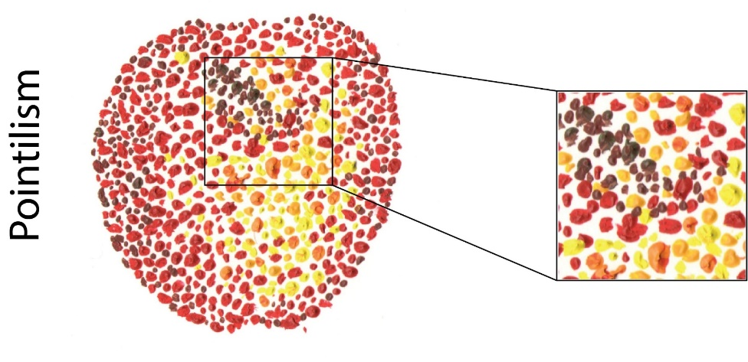
Pointilistic nature of Single-Molecule Localization Microscopy
Adapted from Hoboth et al., Int J Mol Sci 2021

Slide 18
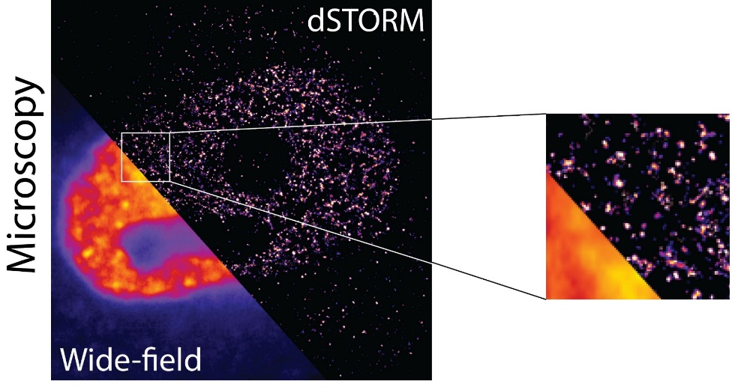
Pointilistic nature of Single-Molecule Localization Microscopy
Adapted from Hoboth et al., Int J Mol Sci 2021

Slide 19
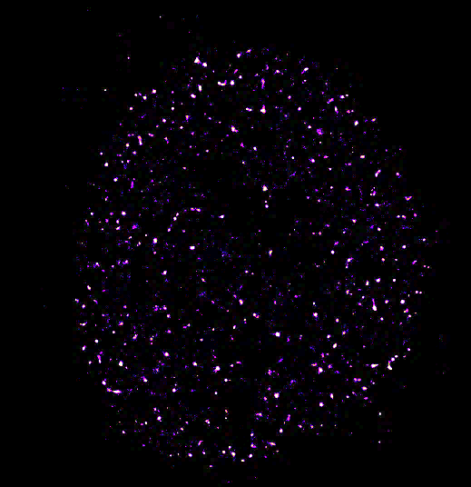
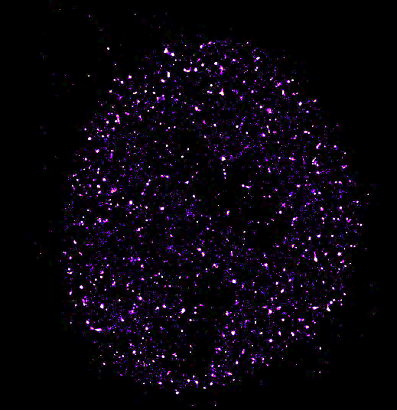
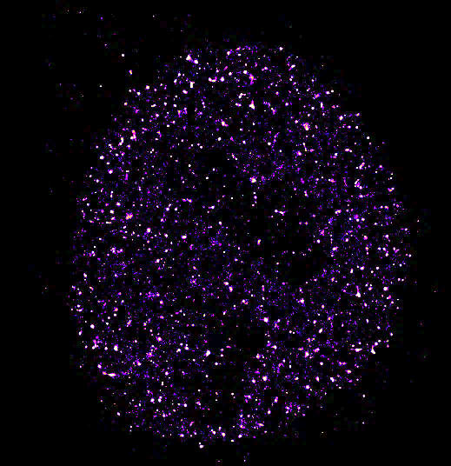
Accumulation of SMLs in dSTORM image
B
C
D
Adapted from Hoboth et al., Int J Mol Sci 2021

Slide 20
Accumulation of oil color spots on canvas
E
F
G
Adapted from Hoboth et al., Int J Mol Sci 2021

Slide 21
SMLM Image is Mathematically Reconstructed from the Coordinates of Individual Molecules
Adapted from Endesfelder and Heilemann 2014

Slide 22
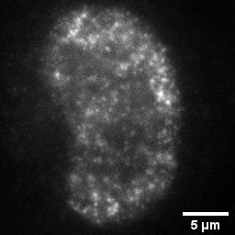
Nuclear PI(4,5)P2 Visualized by Wide-Field Microscopy
WF

Slide 23
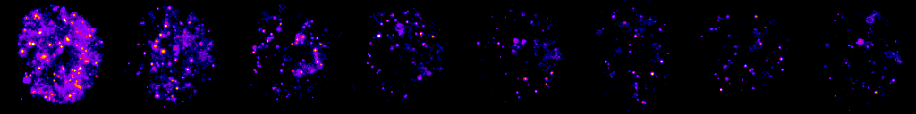
Data Acquisition by 2D dSTORM

Slide 24
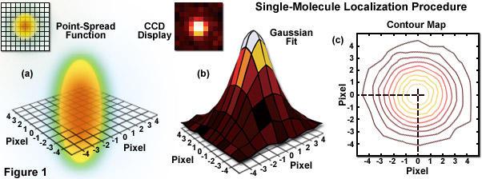
Single-Molecule Localization Procedure
Adapted from Zeiss

Slide 25
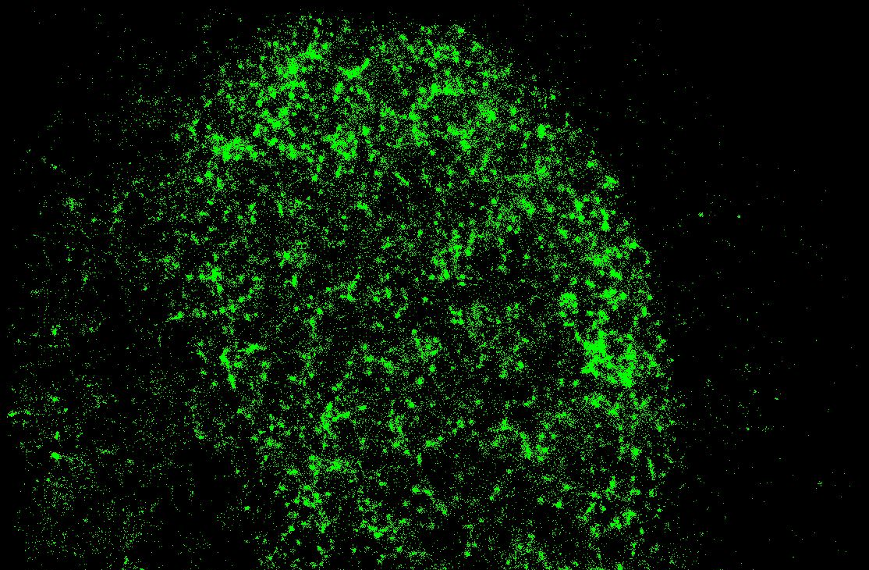
Nuclear PI(4,5)P2 Visualized by 2D dSTORM
Centroids
WF

Slide 26
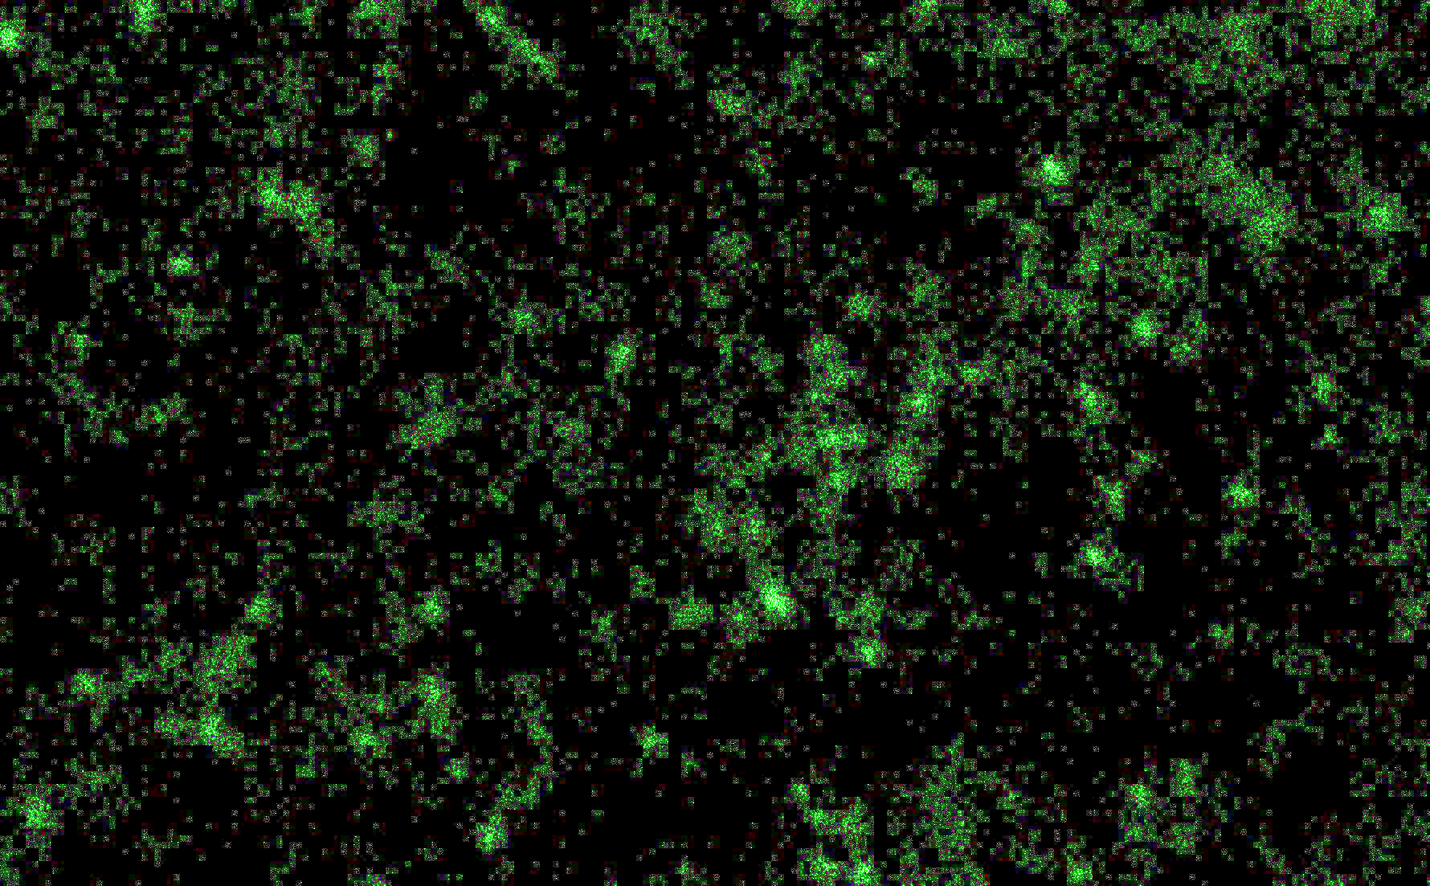
Nuclear PI(4,5)P2 Visualized by 2D dSTORM
Centroids
WF
WF

Slide 27
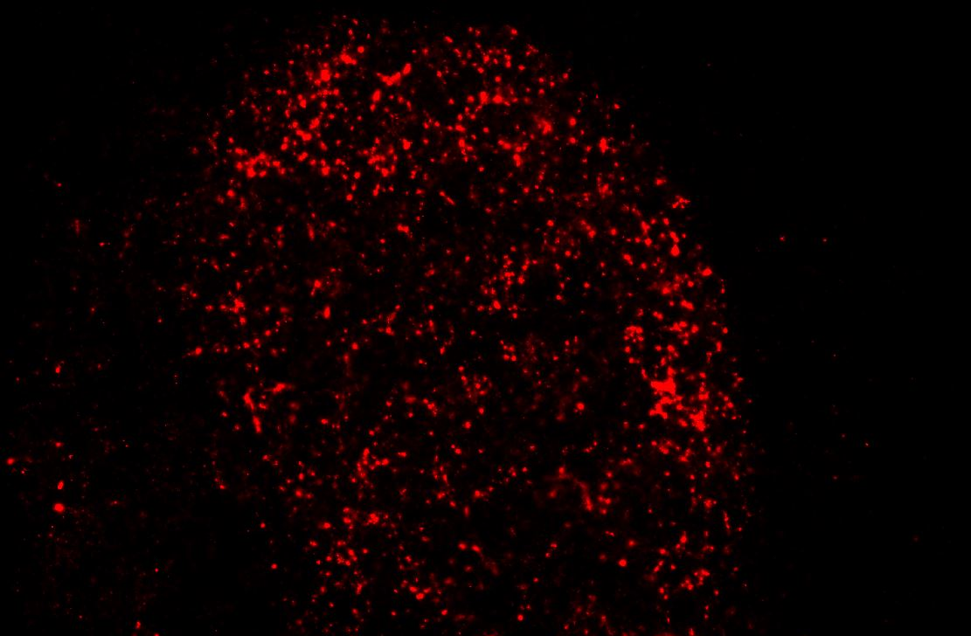
Nuclear PI(4,5)P2 Visualized by 2D dSTORM
Gauss. Fit
Centroids
Localization
Precision
WF

Slide 28
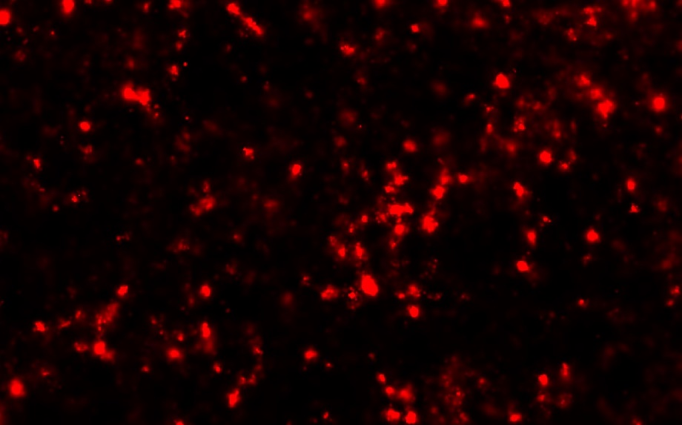
Nuclear PI(4,5)P2 Visualized by 2D dSTORM
Gauss. Fit
Centroids
Localization
Precision
WF

Slide 29
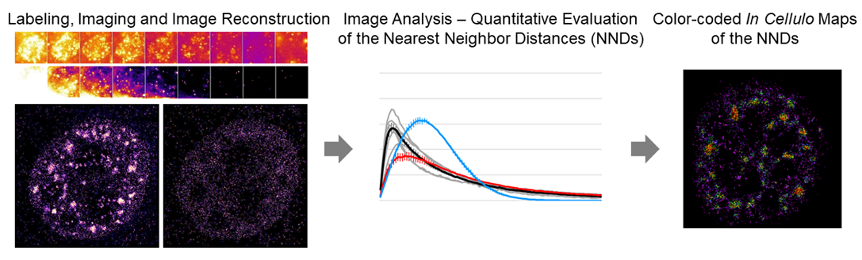
Seeing is believing Labeling, imaging, image reconstruction Measuring is knowing Image analysis & quantification, NND Visualizing is understanding Color-coded in cellulo maps of NNDs

